Slide 1
Graduate attributes
Activity cards
Graduate Attributes activity card set © 2021 by Ann Tilbury, University of the Highlands and Islands is licensed under CC BY 4.0

Slide 2
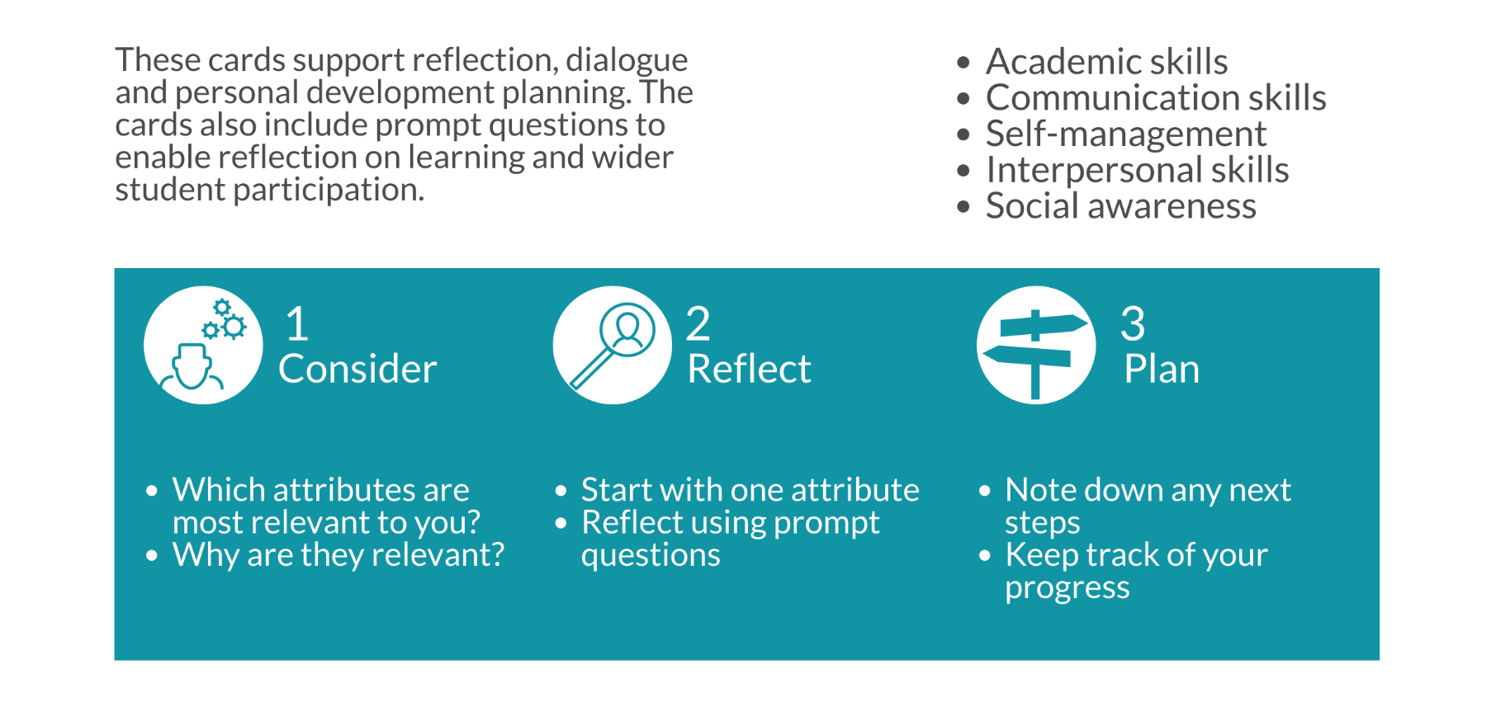
How to use these cards
Graduate Attributes activity card set © 2021 by Ann Tilbury, University of the Highlands and Islands is licensed under CC BY 4.0

Slide 3
Academic skills
Graduate Attributes activity card set © 2021 by Ann Tilbury, University of the Highlands and Islands is licensed under CC BY 4.0

Slide 4
Reflect: How have I developed this attribute through studies and student activities?
Evidence: What specific examples do I have that show my ability in this area?
Plan: How might I develop this attribute further?
Graduate Attributes activity card set © 2021 by Ann Tilbury, University of the Highlands and Islands is licensed under CC BY 4.0

Slide 5
Communication skills
Graduate Attributes activity card set © 2021 by Ann Tilbury, University of the Highlands and Islands is licensed under CC BY 4.0

Slide 6
Reflect: How have I developed this attribute through studies and student activities?
Evidence: What specific examples do I have that show my ability in this area?
Plan: How might I develop this attribute further?
Graduate Attributes activity card set © 2021 by Ann Tilbury, University of the Highlands and Islands is licensed under CC BY 4.0

Slide 7
Self-management
Graduate Attributes activity card set © 2021 by Ann Tilbury, University of the Highlands and Islands is licensed under CC BY 4.0

Slide 8
Reflect: How have I developed this attribute through studies and student activities?
Evidence: What specific examples do I have that show my ability in this area?
Plan: How might I develop this attribute further?
Graduate Attributes activity card set © 2021 by Ann Tilbury, University of the Highlands and Islands is licensed under CC BY 4.0

Slide 9
Social awareness
Graduate Attributes activity card set © 2021 by Ann Tilbury, University of the Highlands and Islands is licensed under CC BY 4.0

Slide 10
Reflect: How have I developed this attribute through studies and student activities?
Evidence: What specific examples do I have that show my ability in this area?
Plan: How might I develop this attribute further?
Graduate Attributes activity card set © 2021 by Ann Tilbury, University of the Highlands and Islands is licensed under CC BY 4.0

Slide 11
Interpersonal skills
Graduate Attributes activity card set © 2021 by Ann Tilbury, University of the Highlands and Islands is licensed under CC BY 4.0

Slide 12
Reflect: How have I developed this attribute through studies and student activities?
Evidence: What specific examples do I have that show my ability in this area?
Plan: How might I develop this attribute further?
Graduate Attributes activity card set © 2021 by Ann Tilbury, University of the Highlands and Islands is licensed under CC BY 4.0

